Slide 1



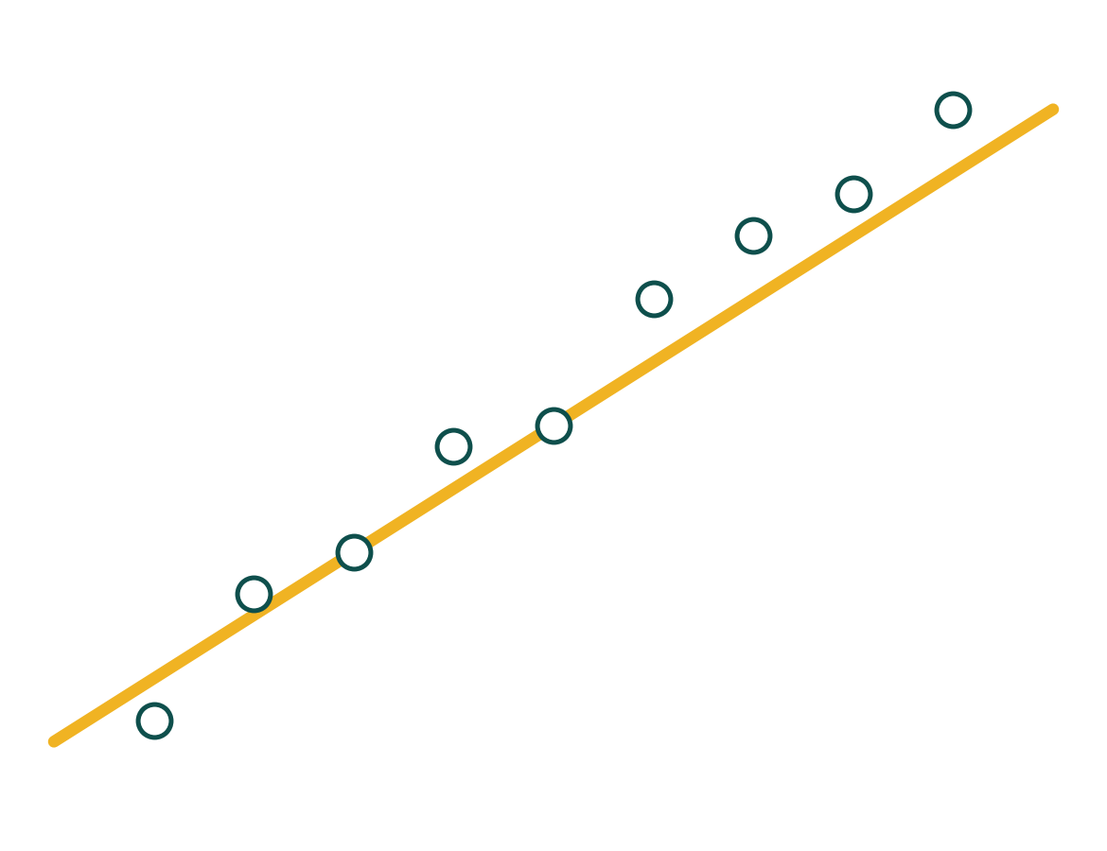
MAWHIBA · GRADE 9 · WEEK 10
Unit 3 · Activity 2
Paired Variables
Which variable do I change, and how exact is the relationship?
Your crew leads. Your teacher facilitates.
Mr Malek Thiab
FAITH, RIGHTEOUSNESS AND WISDOM
Notes:
Teacher notes: Mawhiba Grade 9, Unit 3 Linear functions and relations, Activity 2 Paired variables (Tasks 1 and 2), one session of about 40 minutes. Crews of four form before the session (Grapher, Algebraist, Checker, Reporter; roles rotate each task; stuck ladder: re-read, ask your crew, ask another crew, then the teacher). Advanced performance characteristics to develop: tolerate ambiguity and work with inexact relationships; show insight into the nature of different types of linear relationships in mathematics and science. Reminder: scatter graphs from Activity 1 plot paired observations that may show a relationship; open by asking why it is useful to present data this way (visualise relationships, spot outliers, line of best fit gives an estimate, predictions can be tested, informs further hypotheses). All data on the slides are model values.

Slide 2


Your journey
Four stations, 40 minutes, and plenty of What if...? Each station zooms in as you arrive.
Read it
14 min
Apply and present
10 min
2
4
1
3
Match it
8 min
Judge it
8 min
You will need: the worksheet, a clear ruler, a sharp pencil, and a spreadsheet or GeoGebra if you have one.
FAITH, RIGHTEOUSNESS AND WISDOM
Notes:
Teacher notes: four stations, 40 minutes (Match it 8, Read it 14, Judge it 8, Apply and present 10). Each station zooms in as students arrive; no ability labels, every crew starts at station 1. Pre-session home task covered independent and dependent variables and exact and inexact relationships, so spend no more than two minutes on definitions. Materials: the 3-page worksheet, a ruler, a sharp pencil, a spreadsheet or GeoGebra if allowed.

Slide 3
1
2
3
4
STATION 1 · MATCH IT · 8 MIN
Task 1: match the paired variables
EIGHTEEN CARDS · NINE PAIRS
TASK 1 · PAIRS, THEN FOURS
Temperature
Radioactive decay
Number of people in a lift
Life span
Mileage
The crop yield produced
Match the cards into pairs. One card is the independent variable, one is the dependent variable. Explain the context you chose.
Time in months
Seedling growth
Time in hours
Wind speed
Number of TVs
Total weight of passengers
THE TWO QUESTIONS
Pressure
Children’s heights
Time in years
Virus multiplication
Amount of fertiliser applied to a crop whilst growing
Petrol consumption
Independent: “What do I change?”
Dependent: “What do I observe?”
WHAT IF...?
What if a card could go with more than one partner? Find a card with two possible partners and explain each context.
MAWHIBA GRADE 9 · WEEK 10 · UNIT 3 · ACTIVITY 2
FAITH, RIGHTEOUSNESS AND WISDOM
Mr Malek Thiab · 3
Notes:
Teacher notes: Task 1, minutes 1 to 8. Cut-up cards labelled Unit 3 Activity 2 Task 1 Variables (eighteen cards, nine pairs). Definitions: independent variables answer the question What do I change? Dependent variables answer What do I observe? Example if needed: in a lift the number of people is changed and the total weight is recorded. Let students work without interruption, then pairs join fours to compare and explain context and reasons. Possible pairings from the Guide: number of people in a lift and total weight of passengers; temperature and seedling growth; time in months and children's heights; mileage and petrol consumption; number of TVs and life span; time in hours and virus multiplication; time in years and radioactive decay; pressure and wind speed; amount of fertiliser applied to a crop whilst growing and the crop yield produced. There is more than one way of pairing the cards, so accept any pairing with a justified context. What if (gold strip): temperature could be paired with seedling growth or with wind speed in a weather context; time in hours could pair with virus multiplication or with seedling growth. Verbal misconceptions: the independent variable is the one that is easier to measure; the dependent variable always goes second in time; a pair must be a causal pair (number of TVs and life span are associated, not causal; a third variable such as wealth could sit behind both). Adaptive routing: if >30% of crews cannot start, give the lift example and re-ask the two questions; crews that finish early write for each pair which variable goes on the x-axis and why.

Slide 4
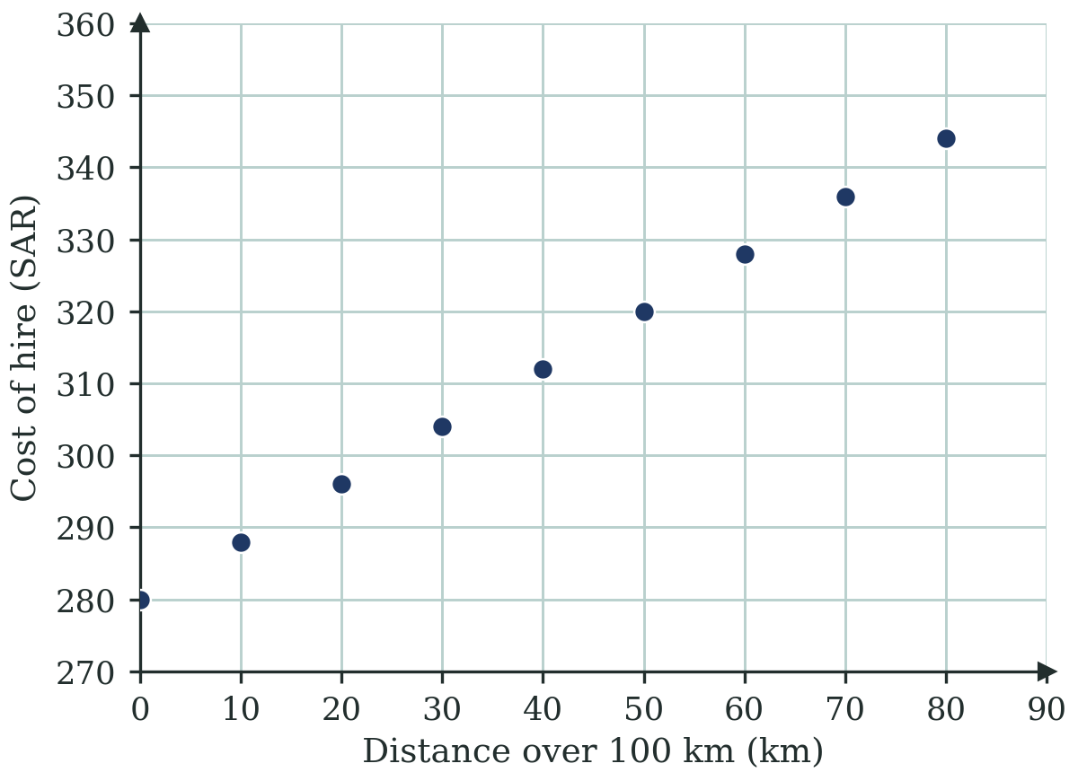
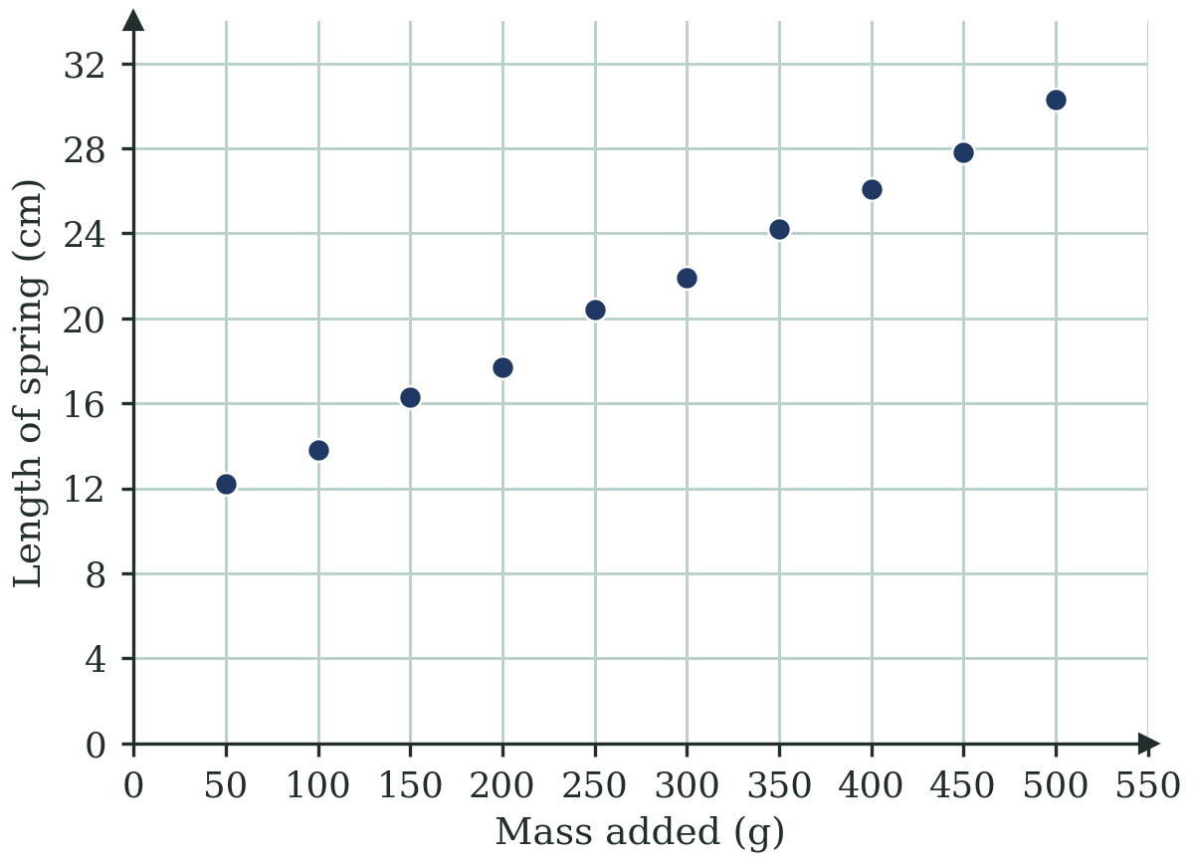
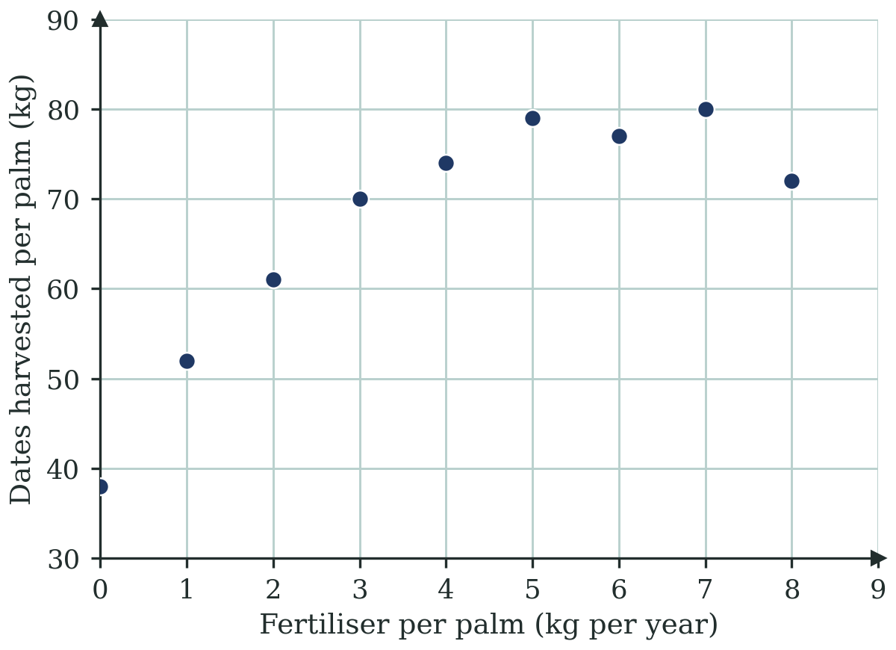
1
2
3
4
STATION 2 · READ IT · 14 MIN
Task 2: three graphs, three kinds of relationship
A
Hiring a car in Jeddah
B
Stretching a spring
C
Fertiliser on date palms
SAR 280 a day, first 100 km included, then SAR 0.80 for each extra km.
Masses are added to a spring and its length is measured with a ruler.
A farm in Al-Ahsa records fertiliser used and dates harvested per palm.
USE THIS VOCABULARY
exact linear relationship
inexact linear relationship
experimental errors
limited assumptions
complex assumptions
MAWHIBA GRADE 9 · WEEK 10 · UNIT 3 · ACTIVITY 2
FAITH, RIGHTEOUSNESS AND WISDOM
Mr Malek Thiab · 4
Notes:
Teacher notes: Task 2, minutes 9 to 14 (part 1 of 2). Show the three graphs and contexts, in pairs then fours, using the vocabulary: exact linear relationship, inexact linear relationship, experimental errors, limited assumptions, complex assumptions. Graph A (model values, adapted from the Guide's car-hire graph): hiring a car in Jeddah costs SAR 280 a day with the first 100 km included, then SAR 0.80 per extra km, so cost C = 0.8d + 280 for d km over 100. Every point lies exactly on the line: for example (10, 288) and (60, 328) give gradient (328 − 288) ÷ (60 − 10) = 0.8 and intercept 288 − 0.8 × 10 = 280. This is an EXACT linear relationship with few, simple assumptions (once the contract is agreed any difference should be marginal). Graph B: a spring stretched by added masses; ideal length 10 + 0.04 × mass, but the measured lengths differ by up to 0.4 cm: an INEXACT linear relationship caused by EXPERIMENTAL ERRORS (reading the ruler, parallax) and LIMITED assumptions (the spring is not stretched past its elastic limit). Graph C: dates harvested per palm against fertiliser; the harvest rises, levels off and falls, so there is a weak, curved or inexact linear relationship with COMPLEX assumptions (soil, water, heat, pests, palm age all interact). Verbal misconceptions: exact means real data, inexact means the experiment was done badly; a high correlation means exact; a model with no complex assumptions must be simple physics. Adaptive routing: if >30% call graph B exact, ask whether any dot sits off the line; if >30% struggle with graph C, ask what else besides fertiliser changes the harvest.

Slide 5
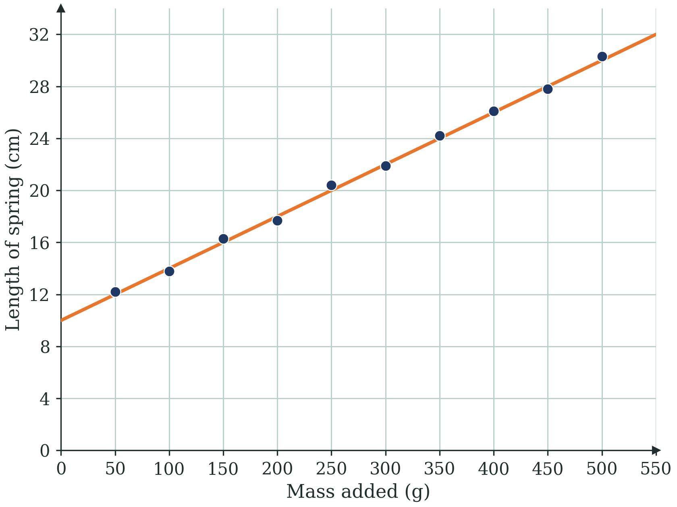

1
2
3
4
STATION 2 · READ IT · 14 MIN
Task 2: how exact is the spring graph?
GRAPH B · A LINE THROUGH THE SPRING DATA
DO THIS
Do the dots lie exactly on the line? Say what that means.
Read the gradient and the intercept from the line.
Name one source of experimental error.
Name one limited assumption about the spring.
WHAT IF...?
What if you hang 5 kg on this spring? Use the line to predict, then decide whether to trust it.
DONE WHEN
You can name the relationship, give a reason, and interpret the gradient and intercept.
MAWHIBA GRADE 9 · WEEK 10 · UNIT 3 · ACTIVITY 2
FAITH, RIGHTEOUSNESS AND WISDOM
Mr Malek Thiab · 5
Notes:
Teacher notes: Task 2, minutes 15 to 22 (part 2 of 2). Graph B data (mass in g, length in cm): (50, 12.2), (100, 13.8), (150, 16.3), (200, 17.7), (250, 20.4), (300, 21.9), (350, 24.2), (400, 26.1), (450, 27.8), (500, 30.3). A line of best fit is y = 0.04x + 10 (gradient 0.04 cm per gram, so every extra 100 g stretches the spring by 4 cm; intercept 10 cm is the natural length with no mass). The largest gap between a dot and the line is 0.4 cm, so the relationship is strong but INEXACT. What if (gold strip): 5 kg is 5000 g, and the line predicts 10 + 0.04 × 5000 = 210 cm, which is impossible for a real spring because it would pass its elastic limit and stay stretched; the line is only trusted inside the range of the readings (50 g to 500 g). Done when: the crew can name the relationship (inexact linear), give a reason (dots scatter about the line, experimental errors), and interpret the gradient and intercept in context. Verbal misconceptions: reading the intercept as the length after 50 g; swapping the axes (length is the dependent variable because it is what we observe); believing the line is wrong because dots are off it. Adaptive routing: if >30% cannot interpret the gradient, ask 'how much longer does the spring get for 100 g?'; crews that finish early compare the three graphs by listing the assumptions behind each.

Slide 6
1
2
3
4
STATION 3 · JUDGE IT · 8 MIN
Judge the claims: true, false or sometimes?
CLAIM A
CLAIM B
CLAIM C
If the dots do not lie exactly on a line, there is no linear relationship.
Only one way of pairing the cards is correct.
The spring line is reliable for any mass.
TEST IT
TEST IT
TEST IT
Look again at graph B.
Find a card with two possible partners.
Put 5000 g into the line.
TRUE
FALSE
SOMETIMES
TRUE
FALSE
SOMETIMES
TRUE
FALSE
SOMETIMES
Because ........................................
Because ........................................
Because ........................................
ASSUMPTION CHECK
ASSUMPTION CHECK
ASSUMPTION CHECK
Does a model need to touch every dot to be useful?
Did I say which context I chose?
Does the spring still behave the same far beyond the readings?
Which graph gave you the strongest evidence: an exact one, an inexact one, or one with complex assumptions? What made you decide?
MAWHIBA GRADE 9 · WEEK 10 · UNIT 3 · ACTIVITY 2
FAITH, RIGHTEOUSNESS AND WISDOM
Mr Malek Thiab · 6
Notes:
Teacher notes: judge the claims, minutes 23 to 30. Claim A: FALSE. Graph B has dots off the line but a strong linear pattern; inexact linear relationships are very common and useful, and the model need not touch every dot. Claim B: FALSE as written, or SOMETIMES. Several pairings can be justified (temperature could be paired with seedling growth or with wind speed in a weather context), so the answer depends on the context chosen; require crews to state their context. Claim C: FALSE. The line gives 10 + 0.04 × 5000 = 210 cm at 5000 g, beyond the readings (50 g to 500 g) and past the elastic limit of any real spring. Assumption checks: does a model need to touch every dot; which context did I choose; does the spring still behave the same far beyond the readings. Plenary: which graph gave the strongest evidence (the exact car-hire graph) and how an inexact graph can still support a useful prediction inside its range. Verbal misconceptions: 'one counter-example is not enough'; 'exact and strong are the same'. Adaptive routing: if >30% mark Claim C true, ask them to compute the length at 5000 g and imagine the spring.

Slide 7
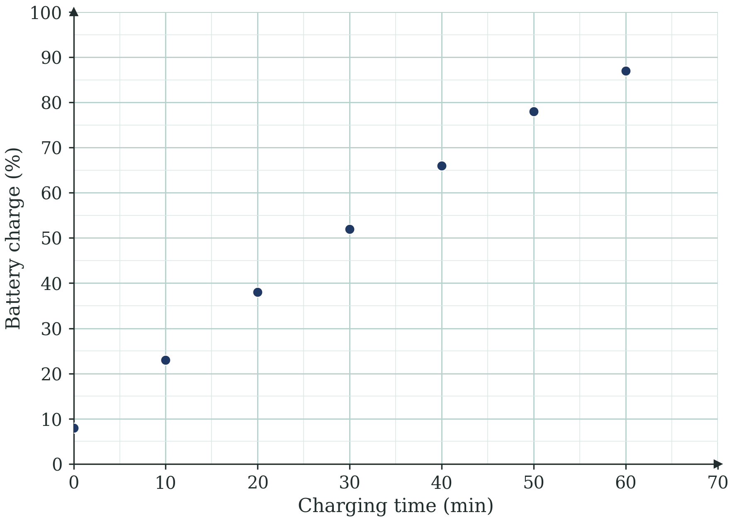
1
2
3
4
STATION 4 · APPLY AND PRESENT · 10 MIN
Apply and present: a fast charger near Jeddah
MODEL VALUES (ILLUSTRATIVE, NOT REAL CHARGER DATA)
PRESENT · 1 MINUTE EACH
An electric car is plugged into a fast charger. The battery charge is recorded every 10 minutes.
Two reporters share evidence: a graph, an equation or numbers.
Share one What if...? your crew asked and one idea that is your own.
Which variable is independent? Which is dependent?
Use the first five readings: find a line and its equation.
Predict the charge after 25 minutes.
What if the car stays 90 minutes? Is the line still sensible? Say exact or inexact, and why.
MY MAWHIBA RECORD: TICK A VALUE
Inquiry
Risk taking
Perseverance
Collaboration
Concern for society
Add today’s evidence to your cumulative record.
MAWHIBA GRADE 9 · WEEK 10 · UNIT 3 · ACTIVITY 2
FAITH, RIGHTEOUSNESS AND WISDOM
Mr Malek Thiab · 7
Notes:
Teacher notes: apply and present, minutes 31 to 40. Model values, not real charger data. Charge (%) against time (min): (0, 8), (10, 23), (20, 38), (30, 52), (40, 66), (50, 78), (60, 87). 1) Independent: charging time (what I change); dependent: battery charge (what I observe). 2) Using the first five readings, the points (10, 23) and (30, 52) give gradient (52 − 23) ÷ (30 − 10) = 1.45 and intercept 23 − 1.45 × 10 = 8.5, so y = 1.45x + 8.5; the other early readings are within 1 percentage point of this line. 3) At 25 minutes: 1.45 × 25 + 8.5 = 44.75, about 45%. 4) What if 90 minutes: the line gives 1.45 × 90 + 8.5 = 139%, which is impossible (a battery cannot exceed 100%); the later readings already fall below the line (at 60 minutes the line says 95.5% but the reading is 87%), because the charger slows down as the battery fills. So the relationship is inexact and linear only for the first 40 minutes or so; the assumptions are complex (battery management, temperature, charger power). Presentation: two reporters, one minute each. Mawhiba record: tick a value shown today and add evidence to the cumulative record. Verbal misconceptions: using all seven dots for one line; reading 139% as a valid answer; calling it exact because the first dots are close. Adaptive routing: if >30% mix up the variables, return to the two questions on slide 3.

